Slide 1


Project On SQL: Sales Data Analysis
Mentorness
Internship
Program
Created By:
Raja Barman

Slide 2



INTRODUCTION
Hello Everyone, I am Raja Barman. I am a data analyst enthusiast. I got selected for Mentorness Internship program and I would like to thank Mentorness for giving me this opportunity. I am here to discuss about the SQL project which is a part of this internship program.
https://github.com/Raja3103
www.linkedin.com/in/raja-barman98

Slide 3

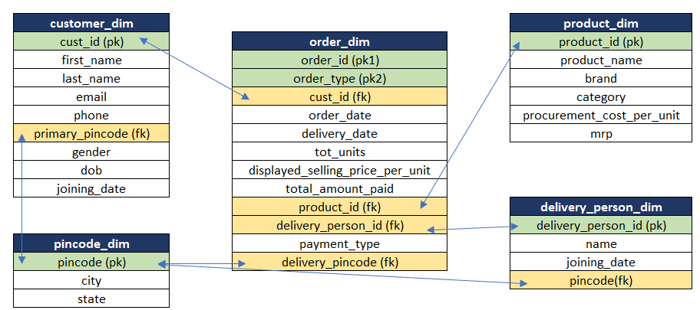
Let’s have a look at the data that we have. We have 5 different tables from where we need to create some insights and find out some information which will help in decision making and business growth.

Slide 4

Question 1
Result
How many customers do not have DOB information available?
Query
select COUNT(cust_id) as Total_missing_DOB_Information from customers$ where dob is null;

Slide 5
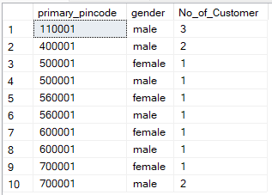
Result
Question 2
How many customers are there in each pincode and gender combination?
Query
select primary_pincode, gender,COUNT(cust_id) as No_of_Customer from customers$
group by gender, primary_pincode
order by primary_pincode;

Slide 6

Question 3
Result
Print product name and mrp for products which have more than 50000 MRP?
Query
select product_name, mrp from products$
where mrp>50000;

Slide 7
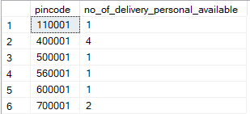
Result
Question 4
How many delivery personal are there in each pincode?
Query
select pincode,COUNT(delivery_person_id) as no_of_delivery_personal_available from delivery_person$
group by pincode
order by pincode;

Slide 8
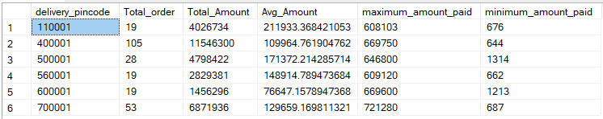
Question 5
Result
For each Pin code, print the count of orders, sum of total amount paid, average amount paid, maximum amount paid, minimum amount paid for the transactions which were paid by 'cash'. Take only 'buy' order types.
Query
select delivery_pincode,COUNT(order_id) as Total_order,SUM(total_amount_paid) as Total_Amount,
sum(total_amount_paid)/COUNT(order_id) as Avg_Amount, MAX(total_amount_paid) as maximum_amount_paid, min(total_amount_paid) as minimum_amount_paid from orders$
where order_type = 'buy' and payment_type = 'cash'
group by delivery_pincode

Slide 9
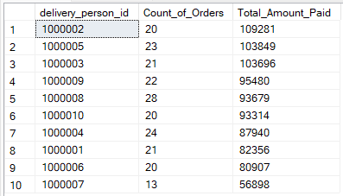
Result
Question 6
For each delivery_person_id, print the count of orders and total amount paid for product_id = 12350 or 12348 and total units > 8. Sort the output by total amount paid in descending order. Take only 'buy' order types
Query
select delivery_person_id ,COUNT(order_id) as Count_of_Orders, SUM(total_amount_paid) as Total_Amount_Paid from orders$
where product_id = '12350' or product_id = '12348' and tot_units > 8 and order_type = 'buy'
group by delivery_person_id
order by Total_Amount_Paid desc;

Slide 10
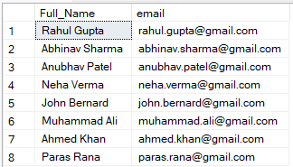
Question 7
Result
Print the Full names (first name plus last name) for customers that have email on "gmail.com"?
Query
select (first_name +' '+ last_name) as Full_Name, email from customers$
where email like '%@gmail.com';

Slide 11

Result
Question 8
Which pincode has average amount paid more than 150,000? Take only 'buy' order types
Query
select delivery_pincode, sum(total_amount_paid)/COUNT(order_id) as Avg_Amount from orders$
where order_type = 'buy'
group by delivery_pincode
having sum(total_amount_paid)/COUNT(order_id) > 150000

Slide 12
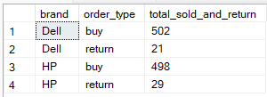
Question 9
Result
How many units have been sold by each brand? Also get total returned units for each brand.
Query
select p.brand, order_type , count(p.brand) as total_sold_and_return
from products$ P
inner join
orders$ O
on p.F1 = o.product_id
group by p.brand, o.order_type
order by p.brand

Slide 13
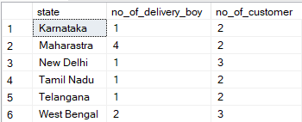
Result
Question 10
How many distinct customers and delivery boys are there in each state?
Query
select p.state, count( distinct d.delivery_person_id) as no_of_delivery_boy,count(distinct c.cust_id) as no_of_customer
from customers$ c
join pincode$ p on c.primary_pincode= p.pincode
join delivery_person$ d on p.pincode = d.pincode
group by p.state

Slide 14
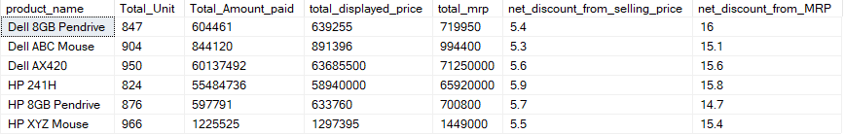
Question 11
Result
For each product name, print the sum of number of units, total amount paid, total displayed selling price, total mrp of these units, and finally the net discount from selling price.
Query
select p.product_name, sum(o.tot_units) as Total_Unit, sum(o.total_amount_paid) as Total_Amount_paid,sum(o.displayed_selling_price_per_unit * o.tot_units) as total_displayed_price,sum(p.mrp*o.tot_units) as total_mrp,round((((sum(o.displayed_selling_price_per_unit * o.tot_units) - sum(o.total_amount_paid))*100)/sum(o.displayed_selling_price_per_unit * o.tot_units)),1) as net_discount_from_selling_price,round((((sum(p.mrp*o.tot_units) - sum(o.total_amount_paid))*100)/sum(p.mrp*o.tot_units)),1) as net_discount_from_MRP
from products$ P
join
orders$ O on p.F1 = o.product_id
where o.order_type = 'buy'
group by p.product_name
order by p.product_name

Slide 15
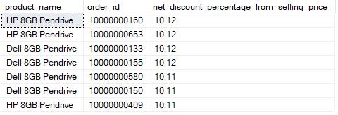
Result
Question 12
For every order_id (exclude returns),get the product name and calculate the discount percentage from selling price. Sort by highest discount and print only those rows where discount percentage was above 10.10%.
Query
select p.product_name, q.order_id, q.net_discount_percentage_from_selling_price
from products$ p join (select O.order_id, o.product_id, round((((sum(o.displayed_selling_price_per_unit *o.tot_units) - sum(o.total_amount_paid))*100) / sum(o.displayed_selling_price_per_unit * o.tot_units)),2) as net_discount_percentage_from_selling_price
from products$ P join orders$ O
on p.F1 = o.product_id where o.order_type = 'buy’
group by o.order_id,o.product_id) q
on p.F1 = q.product_id
where q.net_discount_percentage_from_selling_price >10.10 order by q.net_discount_percentage_from_selling_price desc;

Slide 16
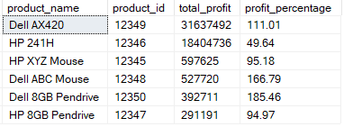
Question 13
Result
Using the per unit procurement cost in product_dim, find which product category has made the most profit in both absolute amount and percentage Absolute Profit
Query
select p.product_name,q.product_id, q.total_profit, q.profit_percentage from products$ p
join (select o.product_id, sum(p.procurement_cost_per_unit*o.tot_units) as total_procurement_cost,sum(o.total_amount_paid) as total_amount_sold,(sum(o.total_amount_paid) - sum(p.procurement_cost_per_unit*o.tot_units)) as total_profit, round (((sum(o.total_amount_paid)- sum(p.procurement_cost_per_unit*o.tot_units))*100) /sum(p.procurement_cost_per_unit*o.tot_units),2) as profit_percentage
from products$ p join orders$ o
on p.F1 = o.product_id where o.order_type ='buy'
group by o.product_id) q
on p.F1 = q.product_id
order by q.total_profit desc

Slide 17
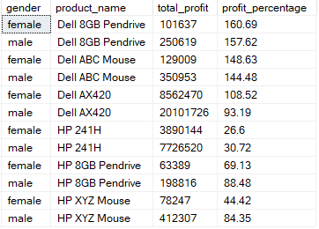
Result
Question 14
For each gender - male and female - find the absolute and percentage profit by product name
Query
select c.gender, p.product_name,(sum(o.total_amount_paid) - sum(p.procurement_cost_per_unit*o.tot_units)) as total_profit, round (((sum(o.total_amount_paid) - sum(p.procurement_cost_per_unit*o.tot_units))*100) / sum(p.procurement_cost_per_unit*o.tot_units),2) as profit_percentage
from customers$ c
join
orders$ o
on c.cust_id = o.cust_id
join products$ p
on p.F1 = o.product_id
group by c.gender, p.product_name;

Slide 18
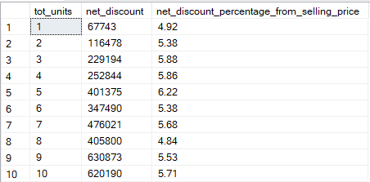
Question 15
Result
Generally the more numbers of units you buy, the more discount seller will give you. For'Dell AX420' is there a relationship between number of units ordered and average discount from selling price? Take 'buy’ order types
Query
select o.tot_units,(sum(o.displayed_selling_price_per_unit * o.tot_units) - sum(o.total_amount_paid)) as net_discount,round((((sum(o.displayed_selling_price_per_unit * o.tot_units) - sum(o.total_amount_paid))*100)/sum(o.displayed_selling_price_per_unit * o.tot_units)),2) as net_discount_percentage_from_selling_price
from orders$ o
join
products$ p
on o.product_id = p.F1
where p.product_name = 'Dell AX420' and o.order_type = 'buy'
group by o.tot_units

Slide 19


